Slide 1
Automated Suggestions for Miscollocations
the Fourth Workshop on Innovative Use of NLP for Building Educational Applications
Authors:Anne Li-E Liu, David Wible, Nai-Lung Tsao
Reporter: Yeh, Chi-Shan

Slide 2
Overview
Abstract
Introduction
Methodology
Experimental Results
Conclusion

Slide 3
Abstract (1/2)
One of the most common and persistent error types in second language writing is collocation errors, such as learn knowledge instead of gain or acquire knowledge, or make damage rather than cause damage.
In this work-in-progress report, we propose a probabilistic model for suggesting corrections to lexical collocation errors.

Slide 4
Abstract (2/2)
The probabilistic model incorporates three features: word association strength (MI), semantic similarity (via Word- Net) and the notion of shared collocations (or intercollocability).
The results suggest that the combination of all three features outperforms any single feature or any combination of two features.

Slide 5
Introduction (1/3)
The importance and difficulty of collocations for second language users has been widely acknowledged.
Liu’s [1] study of a 4-million-word learner corpus reveals that verb-noun (VN) miscollocations make up the bulk of the lexical collocation errors in learners’ essays.
Our study focuses mainly on VN miscollocation correction.
[1] Anne. Li-E Liu 2002. A Corpus-based Lexical Semantic Investigation of VN Miscollocations in Taiwan Learners’ English. Master Thesis, Tamkang University, Taiwan.

Slide 6
Introduction (2/3)
Error detection and correction have been two major issues in NLP research in the past decade.
Studies that focus on providing automatic correction, however, mainly deal with errors that derive from closed-class words, such as articles [2] and prepositions [3].
One goal of this work-in-progress is to address the less studied issue of open class lexical errors, specifically lexical collocation errors.
[2] Na-Rae Han, Martin Chodorow and Claudia Leacock. 2004. Detecting Errors in English Article Usage with a Maximum Entropy Classifier Trained on a Large, Diverse Corpus, Proceedings of the 4th International Conference on Language Resources and Evaluation, Lisbon, Portugal.
[3] Martin Chodorow, Joel R. Tetreault and Na-Rae Han. 2007. Detection of Grammatical Errors Involving Prepositions, Proceedings of the 45th Annual Meeting of the Association for Computational Linguistics, Special Interest Group on Semantics, Workshop on Prepositions, 25-30.

Slide 7
Introduction (3/3)
We focus on providing correct collocation suggestions for lexical miscollocations.
Three features are employed to identify the correct collocation substitute for a miscollocation: word association measurement, semantic similarity between the correction candidate and the misused word to be replaced, and intercollocability.
While we are working on error dection and correction, here we report specifically on our work on lexical miscollocation correction.

Slide 8
Method (1/2)
84 VN miscollocations from Liu’s (2002) study were employed as the training and the testing data in that each comprised 42 randomly chosen miscollocations.
Two experienced English teachers manually went through the 84 miscollocations and provided a list of correction suggestions.
Only when the system output matches to any of the suggestions offered by the two annotators would the data be included in the result.

Slide 9
Method (2/2)
The two main knowledge resources that we incorporated are British National Corpus and WordNet.
BNC was utilized to measure word association strength and to extract shared collocates while WordNet was used in determining semantic similarity.
Note that all the 84 VN miscollocations are combination of incorrect verbs and focal nouns, our approach is therefore aimed to find the correct verb replacements.

Slide 10
Three features adopted
Word Association Measurement
Semantic Similarity
Shared Collocates in Collocation Clusters

Slide 11
Word Association Measurement
Mutual Information (Church et al. 1991)
Two purposes:
All suggested correct collocations have to be identified as collocations.
The higher the word association strength the more likely it is to be a correct substitute for the wrong collocate.

Slide 12
Example
training data:
  Correct collocation: cause damage(MI=3), spend time(MI=5), take medicine(MI=2),.....
  Miscollocation: make damage(MI=-10), pay time(MI=0.2), eat medicine(MI=0.5),....
Then we need get the following probability for testing.
  P(MI / this collocation is correct)

Slide 13
Example
In this simple example, we just divide MI into two ranges: 0~2 and 2~5(in our paper, we use 5 ranges)
Then we get the probability for each range:
P(MI=0~2/ this collocation is correct) = 1/3
P(MI=2~5/ this collocation is correct) = 2/3
If we have a testing data, reach dream, to find all verbs which can be followed by "dream", for example, we find
two candidates: "fulfill" and "make".
We can get the post probability
  P(MI(fufill,dream)=1.5/the collocation is correct) = 1/3.
  P(MI(make,dream)=2.5/the collocation is correct) = 2/3.

Slide 14
Three features adopted
Word Association Measurement
Semantic Similarity
Shared Collocates in Collocation Clusters

Slide 15
Semantic Similarity (1/3)
Both Gitsaki et al. (2000) and Liu (2002) suggest a semantic relation holds between a miscollocate and its correct counterpart.
Following this, we assume that in the 84 miscollocations, the miscollocates should stand in more or less a semantic relation with the corrections.
To measure similarity we take the synsets of WordNet to be nodes in a graph.

Slide 16
Semantic Similarity (2/3)
We quantify the semantic similarity of the incorrect verb in a miscollocation with other possible substitute verbs by measuring graph-theoretic distance between the synset containing the miscollocate verb and the synset containing candidate substitutes.
In cases of polysemy, we take the closest synsets for the distance measure.
If the miscollocate and the candidate substitute occur in the same synset, then the distance between them is zero.

Slide 17
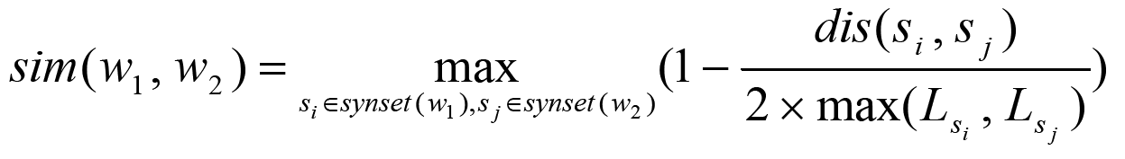
Semantic Similarity (3/3)
The similarity measurement function is as follows:

Slide 18
Example
training data:
  Correct collocation: cause damage, spend time, take medicine,.....
  Miscollocation: make damage, pay time, eat medicine,....
Then we can get the following similarity from WordNet(only verbs with the same noun needed to compute) :
  cause(correct) - make: 0.7
  do(mis) - make: 0.1
  spend(correct) - pay: 0.8
  take(correct) - eat: 0.3

Slide 19
Example
Using these data, we can get the following prior probabilities:
  P(sim=0~0.5/this verb is correct) = 1/3
  P(sim=0.5~1/this verb is correct) = 2/3
If we have a testing data, reach dream, to find all verbs which can be followed by "dream", for example, we find
two candidates: "fulfill" and "make".
Then we compute the similarity of "fulfill" and "make" and "reach".
  fulfill - reach: 0.7
  make - reach: 0.4
We can get the post probability for each candidate
  P(sim(fulfill,reach)/the collocation is correct) = 2/3.
  P(sim(make,reach)/the collocation is correct) = 1/3

Slide 20
Three features adopted
Word Association Measurement
Semantic Similarity
Shared Collocates in Collocation Clusters

Slide 21
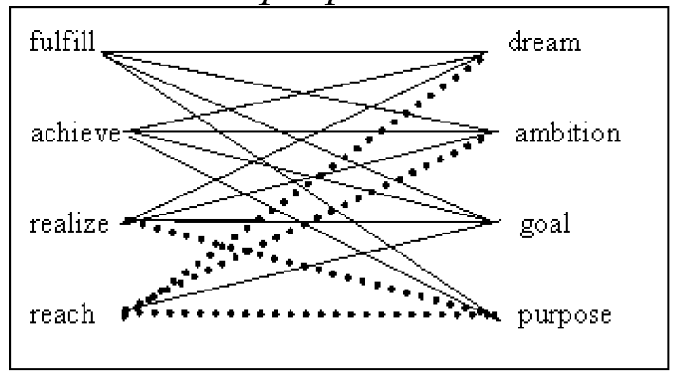
Shared Collocates in Collocation Clusters
Fig. Collocation cluster of “bringing something into actuality”

Slide 22
Example
training data:
  Correct collocation: cause damage, spend time, take medicine,.....
  Miscollocation: make damage, pay time, eat medicine,....
Using "cause damage" and "make damage" as example,we get N1=Noun(cause) and N2=Noun(make) from BNC. (Noun() means the
noun set for a specific verb and only those with high associations can be contained).
If the number of the intersection between N1 and N2 is 60 and the number of N2 is 100(we use N2 because it's miscollocation), the shared collocate score is 0.6.

Slide 23
Example
Using this step, we can get the following data:
  cause - make: 0.6
  do - make: 0.4
  spend-pay: 0.7
  take-eat: 0.3
Using these data, we can get the following prior probabilities (still, two ranges in this example):
  P(0~0.5/this verb is correct) = 2/3
  P(0.5~1/this verb is correct) = 1/3
Again, use "reach dream" as a testing data.
Find all verbs which can be followed by "dream", for example, we find
two candidates: "fulfill" and "make".

Slide 24
Example
Then we compute the shared collocate scores for "fulfill" and "make"
and "reach".
  fulfill - reach: 0.7
  make - reach: 0.4
Then We can get the post probability for each candidate
  P(shared(fulfill,reach)/the collocation is correct) = 2/3.
  P(shared(make,reach)/the collocation is correct) = 1/3

Slide 25
Probabilistic Model (1/2)
The three features we described above are integrated into a probabilistic model.
Each feature is used to look up the correct collocation suggestion for a miscollocation.
For instance, cause damage, one of the possible suggestions for the miscollocation make damage, is found to be ranked the 5th correction candidate by using word association measurement merely, the 2nd by semantic similarity and the 14th by using shared collocates. If we combine the three features, however, cause damage is ranked first.

Slide 26

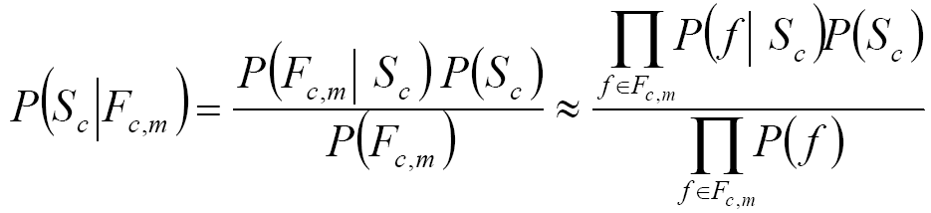
Probabilistic Model (2/2)
The conditional probability:
According to Bayes theorem and Bayes assumption, which assume that these features are independent, the probability can be computed by:

Slide 27
Training
Probability distribution of word association strength
MI value to 5 levels
(<1.5, 1.5~3.0, 3.0~4.5, 4.5~6, >6)
P( MI level )
P(MI level | S_{c} )

Slide 28
Training
Probability distribution of semantic similarity
Similarity score to 5 levels
(0.0~0.2, 0.2~0.4, 0.4~0.6, 0.6~0.8 and 0.8 ~1.0 )
P(SS level )
P(SS level | S_{c} )

Slide 29
Training
Probability distribution of intercollocability
Normalized shared collocates number to 5 levels
(0.0~0.2, 0.2~0.4, 0.4~0.6, 0.6~0.8 and 0.8 ~1.0 )
P(SC level )
P(SC level | S_{c} )

Slide 30
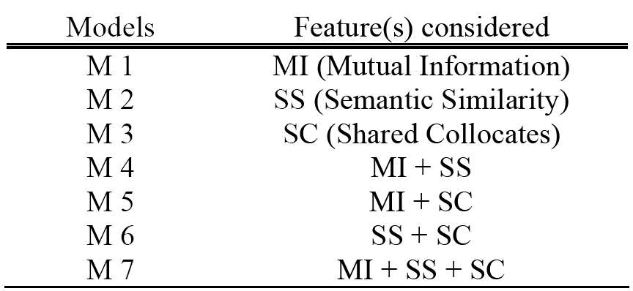
Experimental Results (1/5)
Different combinations of the three features.

Slide 31
Experimental Results (2/5)
K-Best | M1 | M2 (SS) | M3 | M4 | M5 | M6 (SS+SC) | M7 (MI+SS+SC)
1 | 16.67 | 40.48 | 22.62 | 48.81 | 29.76 | 55.95 | 53.75
2 | 36.90 | 53.45 | 38.10 | 60.71 | 44.05 | 63.1 | 67.86
3 | 47.62 | 64.29 | 50.00 | 71.43 | 59.52 | 77.38 | 78.57
4 | 52.38 | 67.86 | 63.10 | 77.38 | 72.62 | 80.95 | 82.14
5 | 64.29 | 75.00 | 72.62 | 83.33 | 78.57 | 83.33 | 85.71
6 | 65.48 | 77.38 | 75.00 | 85.71 | 83.33 | 84.52 | 88.10
7 | 67.86 | 77.38 | 77.38 | 86.90 | 86.90 | 86.90 | 89.29
8 | 70.24 | 80.95 | 82.14 | 86.90 | 89.29 | 88.10 | 91.67
9 | 72.62 | 83.33 | 85.71 | 88.10 | 92.86 | 90.48 | 92.86
10 | 76.19 | 86.90 | 88.10 | 88.10 | 94.05 | 90.48 | 94.05

Slide 32
Experimental Results (3/5)
The K-Best suggestions for “get knowledge”.
K-Best | M2 | M6 | M7
1 | aim | obtain | acquire
2 | generate | share | share
3 | draw | develop | obtain
4 | obtain | generate | develop
5 | develop | acquire | gain

Slide 33
Experimental Results (4/5)
The K-Best suggestions for *reach purpose.
K-Best | M2 | M6 | M7
1 | achieve | achieve | achieve
2 | teach | account | account
3 | explain | trade | trade
4 | account | treat | fulfill
5 | trade | allocate | serve

Slide 34
Experimental Results (5/5)
The K-Best suggestions for *pay time.
K-Best | M2 | M6 | M7
1 | devote | spend | spend
2 | spend | invest | waste
3 | expend | devote | devote
4 | spare | date | invest
5 | invest | waste | date

Slide 35
Conclusion (1/2)
A probabilistic model to integrate features.
Applying such mechanisms to other types of miscollocations.
Miscollocation detection will be one of the main points of this research.
A larger amount of miscollocations should be included in order to verify our approach.

Slide 36
Conclusion (2/2)
Further, a larger amount of miscollocations should be included in order to verify our approach and to address the issue of the small drop of the full-hybrid M7 at k=1.

